Slide 1
HTML FORMS

Slide 2
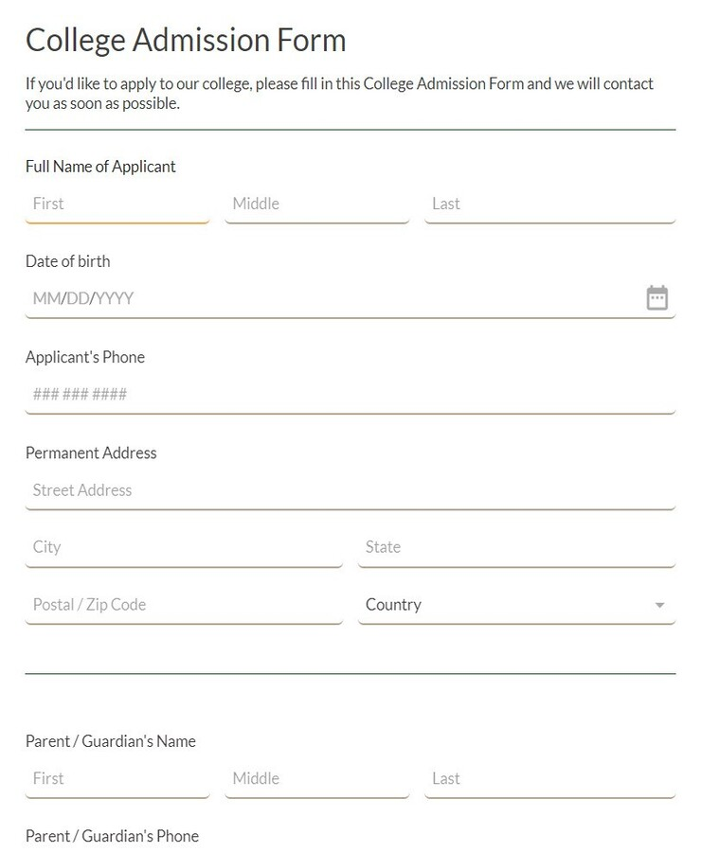
Common Types of
web forms
Admission form

Slide 3
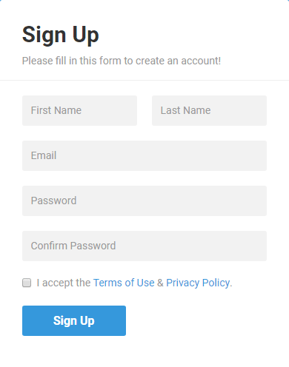
Sign Up Form

Slide 4
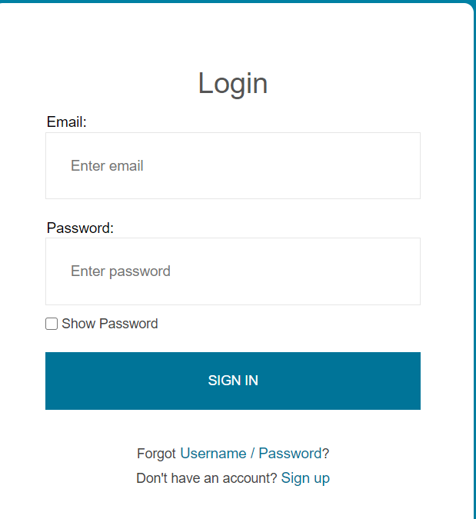
Sign In Form

Slide 5
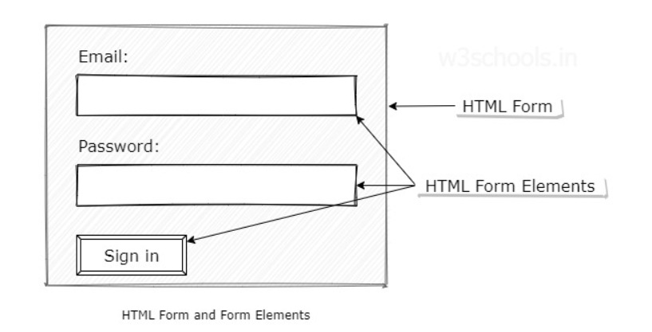


Slide 6
HTML Form tag (<form>)
The <form> tag in HTML is a container element that is used to collect user input and send it to a server for processing.
It groups together input fields like text boxes, radio buttons, checkboxes, dropdowns, and buttons.
In simple words: “The <form> tag creates a section on a web page where users can enter data and submit it.”

Slide 7
Elements of Form
Label
Input
Checkbox
Radio
TextArea
Button
Select
Fieldset
Datalist

Slide 8
<label> tag
The <label> HTML element represents a caption for a form element in a user interface. It improves accessibility by linking text to form elements.

Slide 9
Attributes of <label> tag
For: It refers to the input control that this label is for. Its value must be the same as the value of the input control's "id" attribute.
Form: It refers to the form to which the label belongs to.

Slide 10
<input> tag
The <input> tag in HTML is used to collect user input in web forms. It supports various input types such as text, password, checkboxes, radio buttons, and more.
An input field can be of various types depending upon the attribute type. The Input tag is an empty element that only contains attributes. For defining labels for the input element, <label> can be used.

Slide 11
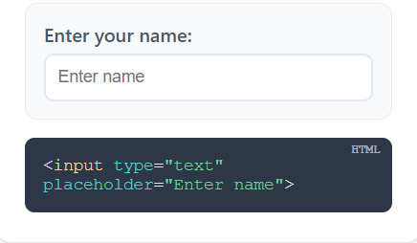
Attributes of <input> tag
type: Specifies the type of input (text, password, email, number, checkbox, radio, button, submit, file, etc.)
Common input types :-
Single-line text input :
<input type="text">

Slide 12
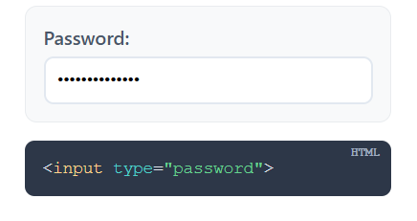
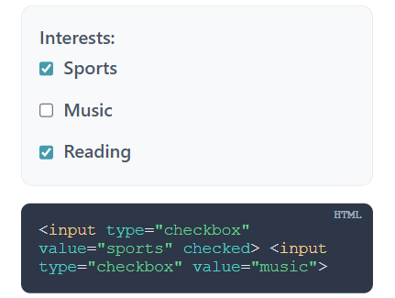
Masked text input for passwords :
<input type="password">
Toggle for selecting multiple options :
<input type="checkbox">

Slide 13
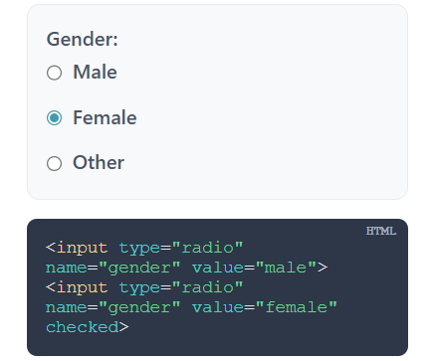
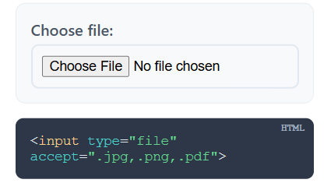
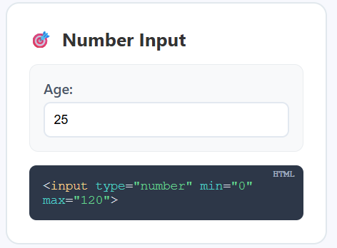
Single selection from multiple options :
<input type="radio">
Input for uploading files :
<input type="file">
Input for numerical values :
<input type="number">

Slide 14
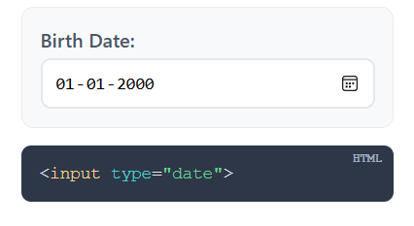
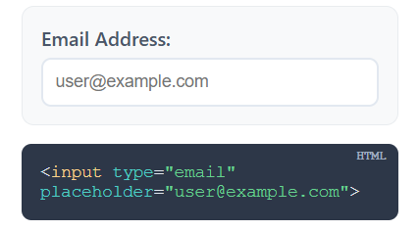
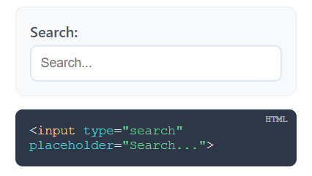
Input for selecting dates :
<input type="date">
Input for email addresses :
<input type="email">
Input for Search :
<input type="search">

Slide 15
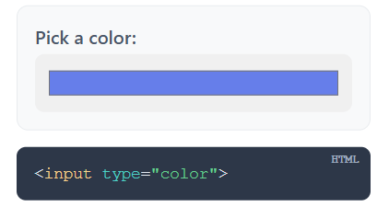
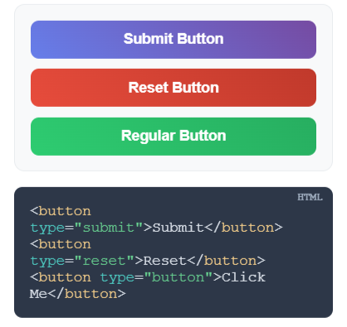
Input for selecting colors :
<input type="color">
Buttons from input :
<input type="button">
<input type="reset">
<input type="submit">

Slide 16
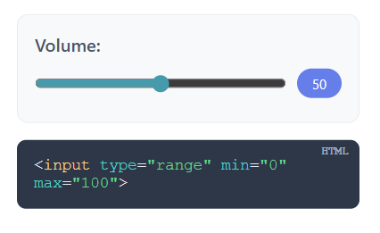
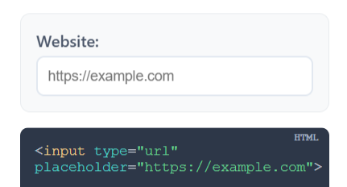
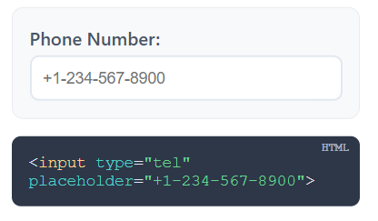
Slider for selecting a numeric value
within a range
<input type="range">
Input for url :
<input type="url">
Input for telephone number :
<input type="tel">

Slide 17
placeholder : Text displayed inside the input when it is empty, as a hint to the user
name : Specifies the name of the input, used to identify the input data when submitting a form
value : Sets the initial value of the input or the value submitted with the form
id : Unique identifier for the input, used with labels
required : Makes the input mandatory before submitting the form
readonly : Makes the input uneditable by the user but still sent with the form

Slide 18
disabled : Makes the input uneditable and not submitted with the form
maxlength : Limits the maximum number of characters allowed
min/max : Sets minimum and maximum values for numeric, date, or range inputs
step : The step attribute sets the size of the jumps between valid values in an input field.
checked : Preselects checkboxes or radio buttons
autocomplete : Enables or disables browser autocomplete for the input
autofocus : Automatically focuses the input when the page loads

Slide 19
Checkbox
<input> elements of type checkbox are rendered by default as boxes that are checked (ticked) when activated, like you might see in an official government paper form. The exact appearance depends upon the operating system configuration under which the browser is running. Generally this is a square but it may have rounded corners. A checkbox allows you to select single values for submission in a form (or not).

Slide 20
Attributes of Checkbox
name : Groups checkboxes together. The value of name is sent when the form is submitted.
value : The value sent to the server if the checkbox is checked.
checked : Pre-selects the checkbox (checked by default).
id : Unique identifier. Often used with <label> for accessibility.
disabled : Makes the checkbox unclickable (cannot be selected).
required : Forces the user to check at least one checkbox in a group before submitting the form.
form : Associates the radio button with a specific <form> even if placed outside of it.

Slide 21
Example
<p>Select your Hobbies:</p>
<input type="checkbox" id="reading" name="hobby" value="reading">
<label for="reading">Reading</label><br>
<input type="checkbox" id="sports" name="hobby" value="sports">
<label for="sports">Sports</label><br>
<input type="checkbox" id="music" name="hobby" value="music">
<label for="music">Music</label>

Slide 22
Important Points
Needs name and value
If a checkbox is unchecked when its form is submitted, neither the name nor the value is submitted to the server
If you do not set a value attribute, and the checkbox is checked, the browser will send :
name = “on”

Slide 23
Radio Button
<input> elements of type radio are generally used in radio groups—collections of radio buttons describing a set of related options.
Only one radio button in a given group can be selected at the same time. Radio buttons are typically rendered as small circles, which are filled or highlighted when selected.
Attributes of radio buttons are same as Checkboxes

Slide 24
Example
<p>Select your gender:</p>
<input type="radio" id="male" name="gender" value="male" checked>
<label for="male">Male</label><br>
<input type="radio" id="female" name="gender" value="female">
<label for="female">Female</label><br>
<input type="radio" id="other" name="gender" value="other">
<label for="other">Other</label>

Slide 25
Important Points
Needs name and value
If no radio button is checked when its form is submitted, neither the name nor the value is submitted to the server
If you do not set a value attribute, and the radio button is checked, the browser will send :
name = “on”

Slide 26
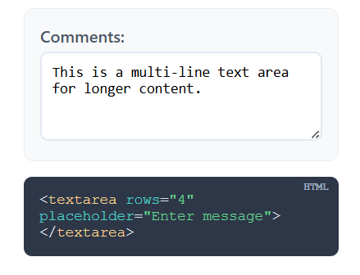
<textarea> tag
The <textarea> tag in HTML is used to create a multi-line text input field, unlike <input type="text"> which is for single-line input. It’s commonly used for messages, comments, or longer user input.
The size of a text area is specified by the cols and rows attributes

Slide 27
Attributes of <textarea> tag
cols : Specifies the visible width of a text area
rows : Specifies the visible number of lines in a text area
maxlength ,readonly ,required ,autofocus ,name ,disabled

Slide 28
Example
<textarea id="feedback"
name="feedback"
rows="5"
cols="40"
placeholder="Write your feedback here...">
</textarea>

Slide 29
<button> tag
The <button> tag defines a clickable button.
Inside a <button> element you can put text , tags ( <i>, <b>, <strong>, <br>, <img>, etc.) or even images . That is not possible with a button created with the <input> element!
Syntax :
<button>BUTTON</button>

Slide 30
Attributes of <button> tag
type : Specifies button behavior
Common button types:- submit , reset , button
name : Name of the button, useful for identifying it in form submission
value : Value sent to the server when the button is clicked (mainly for submit)

Slide 31
formtarget: specifies where to display the response after submitting the form.
Common formtarget :- _blank , _self, _parent , _top.
disabled : Specifies that a button should be disabled
form : specifies which form the button belongs to.

Slide 32
Example
<form>
<!-- Submit button →
<button type="submit" name="submitBtn" value="sendForm"> Submit </button>
<br><br>
<!-- Reset button -->
<button type="reset">Reset </button>
</form>

Slide 33
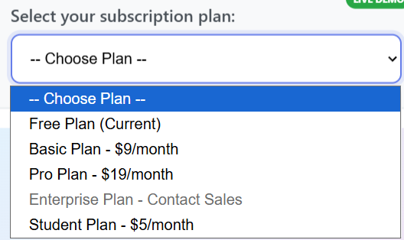
<select> tag
The HTML <select> tag is used to create a drop-down list for user input, containing <option> tags to display the available choices. It provides functionality for selecting one or multiple options from a list.
Syntax :-
<select>
<option></option>
<option></option>......
</select>

Slide 34
Attributes of <select> tag
autofocus :- This attribute allows a dropdown menu (select element) to receive focus when the page loads automatically.
disabled :- This is used to specify that the select element is disabled. A disabled drop-down list is unclickable and unusable.
form :- This specifies the drop down list's associated form, identified by the id attribute of a <form> element.
multiple :- It is a Boolean Attribute. It specifies that the user is allowed to select more than one value that presents in <select> element.

Slide 35
name :- It is used to specify a name for the drop-down list. It is used to reference the form-data after submitting the form.
required :- It is a Boolean attribute which is used to specify that the user should be selected value before submitting the Form.
size :- It is used to specifies the number of visible options in a drop-down list.
Note: If the value of the size attribute is greater than 1 but lower that the number of options in a DropDown List. so the Browser will automatically add the scrollbar for specifying that there are more options to view.

Slide 36
Attributes of <option> tag
Disabled :- This attribute contains the value disabled which represents the option is disabled.
Label :- This attribute contains the text value which represents the shorted label for the option.
Selected : - This attribute contains the value selected which represents the item that is pre-selected when the browser loaded.
Value :- This attribute contains the value text sent to the server.
Note :- All the attributes mentioned are optional. but it’s recommended to add value attribute.

Slide 37
Example
<label for="fruit">Choose a fruit:</label>
<select name="fruit" id="fruit">
<option value="apple">Apple</option>
<option value="banana">Banana</option>
<option value="orange">Orange</option>
<option value="mango">Mango</option>
</select>

Slide 38
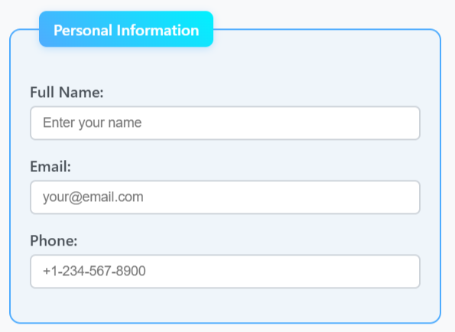
<fieldset> tag
The <fieldset> tag is used to group related elements in a form.
The <fieldset> tag draws a box around the related elements.
The <legend> tag is used to define a caption for the <fieldset> element.

Slide 39
Attributes of <fieldset> tag
disabled :Specifies that a group of related form elements should be disabled
form :Specifies which form the fieldset belongs to
name :Specifies a name for the fieldset

Slide 40
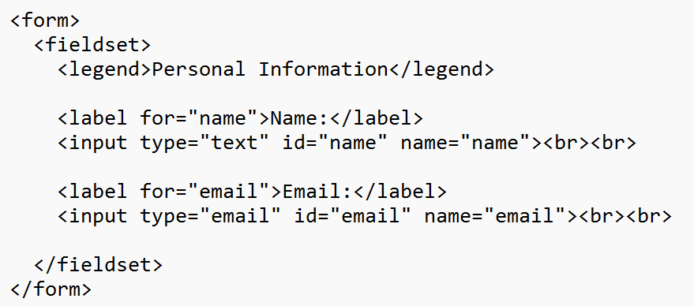
Example

Slide 41
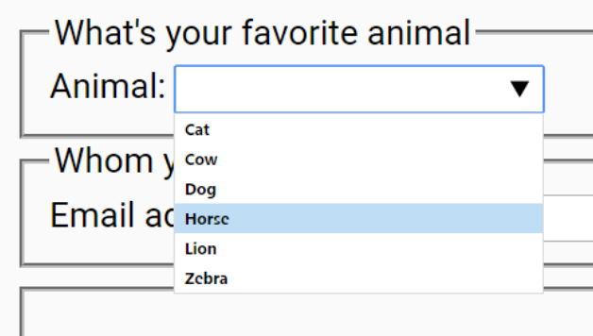
<datalist> tag
The <datalist> tag specifies a list of pre-defined options for an <input> element.
The <datalist> tag is used to provide an "autocomplete" feature for <input> elements. Users will see a drop-down list of pre - defined options as they input data.
The <datalist> element' s id attribute must be equal to the <input> element's list attribute (this binds them together).

Slide 42
EXAMPLE:
<label for="browser">Choose a browser:</label>
<input list="browsers" id="browser" name="browser" placeholder="Start typing...">
<datalist id="browsers">
<option value="Edge">
<option value="Firefox">
<option value="Chrome">
<option value="Opera">
<option value="Safari">
</datalist>

Slide 43
Attributes of form tag
action: This attribute specifies where to send the form-data when a form is submitted. The value of this attribute is typically a URL.
method: This attribute defines the HTTP method used to send the form-data. The values can be “get” or “post”.
target: This attribute specifies where to display the response received after submitting the form. The values can be “_blank”, “_self”, “_parent”, “_top”.

Slide 44
enctype: This attribute is used when method=“post”. It specifies how the form-data should be encoded when submitting it to the server. The values can be “application/x-www-form-urlencoded”, “multipart/form-data”, or “text/plain”.
autocomplete: This attribute specifies whether a form should have autocomplete on or off. When autocomplete is on, the browser automatically completes values based on values that the user has entered before.
novalidate: This Boolean attribute specifies that the form-data should not be validated on submission.

Slide 45
Example
<form action="https://example.com/submit"
method="post"
target="_blank"
enctype="multipart/form-data"
autocomplete="on"
novalidate>
// elements
</form>

Slide 46
Media Tags
Media tags in HTML are special tags used to embed audio, video, and other multimedia content directly into a web page, so users can play music, watch videos, or view captions without needing extra software.
Media Tags are :-
<audio>
<video>
<embed>
<object>
<iframe>

Slide 47
<audio> tag
The <audio> tag in HTML5 is used to embed audio content on a webpage. It allows you to play audio files directly in the browser. The <audio> element provides attributes for controlling playback, such as play, pause, and volume.
Syntax :-
<audio src="sample.mp3" type="audio/mpeg" controls>
</audio> OR
<audio>
<source src="sample.mp3" type="audio/mpeg">
</audio>

Slide 48
Attributes of <audio> tag
Controls :- It is used to specify that the audio and video controls must be displayed (adds play/pause, volume, and timeline controls.).
Autoplay :- It is a boolean attribute, enables audio or video elements to start playing automatically when the page loads, providing seamless playback without interruption.
Muted :- it is used to specify the audio output of the video is muted.
Src :- It specifies the URL or file path of an external resource, such as an image, video, audio file, or script, to be embedded or referenced within a webpage.
Loop :- It is used to restart the audio again and again after finishing it.

Slide 49
Example
<audio controls autoplay loop muted>
<source src="song.mp3" type="audio/mp3">
<source src="song.ogg" type="audio/ogg">
</audio>

Slide 50
<video> tag
The <video> element in HTML is used to show video content on web pages. It supports various video formats, including MP4, WebM, and Ogg. It is introduced in HTML5.
SYNTAX :-
<video src="video_filename" controls> </video> OR
<video controls="controls">
<source src="video_filename" type="video_type">
</video>

Slide 51
Attributes of Video Tag
Controls:- Adds playback controls such as play, pause, volume, etc.
Width :- Specifies the width of the video player.
Height :- Specifies the height of the video player.
Autoplay :- Automatically starts playing the video when it's loaded.
Muted :- Mutes the video by default.
Src :- Specifies the video file’s path.
Poster :- The poster attribute specifies an image to be shown as a preview before the video starts playing.
Type :- Defines the format of the video (e.g., video/mp4, video/webm).

Slide 52
Example
<video controls width="480" poster="thumbnail.jpg">
<source src="movie.mp4" type="video/mp4">
<source src="movie.webm" type="video/webm">
</video>

Slide 53
<embed> tag
The <embed> tag in HTML is used to embed external content or media files (such as audio, video) directly into a webpage.
It is a self-closing tag
It is often used for embedding files like PDFs, images, or other types of media that require a plugin or external application to display.
Notes:
No fallback

Slide 54
Attributes of <embed> tag
Height :- This attribute contains the attribute value in pixels. It is used to specify the height of the embedded content.
Src :- It is used to hold the URL. It is used to specify the web address of the embedded content.
Width :- The width value is set in pixels. It is used to specify the width of embedded content.
Type :- It contains the media_type content. It is used to specify the media type of the embedded content.

Slide 55
Example
<embed src="path/to/your/file.pdf" width="600" height="400" type="application/pdf">

Slide 56
Object Tag
The <object> tag is used to display multimedia like audio, videos, images, PDFs, and Flash on web pages. It can also be used for displaying another webpage inside the HTML page.

Slide 57
Attributes of <object> tag
Data :- It specifies the URL of data in the object.
Type :- It specifies the media type of data specified in the data attribute.
Align :- It defines the alignment of the objects.
Border :- It specifies the border around the object.
Width / Height :- It specifies the width and height of the object.
Name :- It specifies the name for an object.

Slide 58
Example
<object data="document.pdf" type="application/pdf" width="600" height="400">
<p>Your browser does not support PDFs.
<a href="document.pdf">Download the PDF</a>.</p>
</object>

Slide 59
Iframe tag <iframe>
An iframe, or Inline Frame, is an HTML element represented by the <iframe> tag. It functions as a 'window' on your webpage through which visitors can view and interact with another webpage from a different source. embedding another HTML page into the current one.
Iframes are used for various purposes like:
Embedding Multimedia: Easily integrate videos, audio, or animations from platforms like YouTube, etc.
Including Maps: Embed maps from services like Google Maps directly into your site.

Slide 60
Attributes of <iframe> tag
src :- Specifies the URL of the page or resource to be embedded.
width and height :- Define the size of the iframe (in pixels or percentage).
title :- Provides a text description for accessibility.
name :- Gives the iframe a name so it can be targeted by links.
allowfullscreen :- Lets the iframe content go fullscreen (useful for videos, games, maps).

Slide 61
loading (HTML5) :- Controls lazy loading of the iframe for performance.
Values:
lazy → Loads only when scrolled into view.
eager → Loads immediately (default).

Slide 62
HTML favicon
A favicon (short for "favorite icon") is a small yet important image that appears next to your website’s title in the browser tab. Also known as a tab icon or bookmark icon, it helps users quickly identify and return to your site.
They are used for several key purposes:
Brand Recognition: They act as a visual marker that supports brand awareness.
Professionalism: A well-designed favicon makes your site appear more credible.
Usability: It enhances user experience by making it easier to locate your tab among many open ones.

Slide 63
How to add favicon
Create Your favicon: Design a small image, typically 16x16 or 32x32 pixels, and save it in an appropriate format like .ico, .png, or .svg. In this example, we're using a .png format.
Upload the favicon: Upload your favicon image to your website's root directory, or in this case, we'll use an external URL for the image.
Add the favicon to HTML: Open your HTML file and add a <link> tag in the <head> section that points to the favicon.
Test Your favicon: After adding the code, save your changes and upload the file to your server if you're working locally.

Slide 64
Syntax to add the favicon
<link rel="icon" href="favicon.ico" type="image/x-icon">
<link rel="icon" href="favicon.png" type="image/png">

Slide 65
HTML meta tag
A meta tag in HTML is an element that provides metadata about the HTML document. Metadata is data that describes other data, and in this case, it helps search engines and browsers understand how to handle or display content. The <meta> tag does not appear directly on the webpage, but it provides information to search engines, browsers, and other services that interact with the page.
Syntax:-
<meta name="name_of_the_meta_tag" content="value_of_the_meta_tag">

Slide 66
Types of meta tags
Character Encoding Meta Tag
<meta charset="UTF-8">
Description Meta Tag
<meta name="description" content="HTML and CSS">
Keywords Meta Tag
<meta name="keywords" content="HTML, CSS, JavaScript">

Slide 67
Author Meta Tag
<meta name="author" content="John Doe">
Viewport Meta Tag
<meta name="viewport" content="width=device-width, initial-scale=1.0">
Refresh Meta Tag
<meta http-equiv="refresh" content="30">

Slide 68
Validation in HTML Forms
The process of ensuring that the data entered by the user is correct, complete, and in the proper format before the form is submitted.
Why we need validation
To prevent wrong or incomplete data (e.g., empty email, invalid age).
To improve user experience (instant error messages).
To reduce errors on the server.

Slide 69
Types of Validation
Client-side validation: Done in the browser using HTML5 attributes (required, pattern, type, etc.). Fast but not 100% secure.
Server-side validation: Done on the server after submission. Slower but more secure and mandatory.

Slide 70
Constraint Validation
This is a set of rules and attributes provided by HTML5 that the browser uses to automatically validate user input.
It is basically how HTML enforces restrictions (constraints) on form fields.

Slide 71
Important Constraint Validation Attributes:
required → field cannot be left empty
min / max → numeric range constraints
minlength / maxlength → character length restrictions
step → input must increase/decrease in fixed steps
type → ensures input is of correct format (email, url, number, date, etc.)

